Slide 1
DE - A Domain Specific Language (DSL) for Data Explore
Xinyu Max Liu
05/15/2017

Slide 2
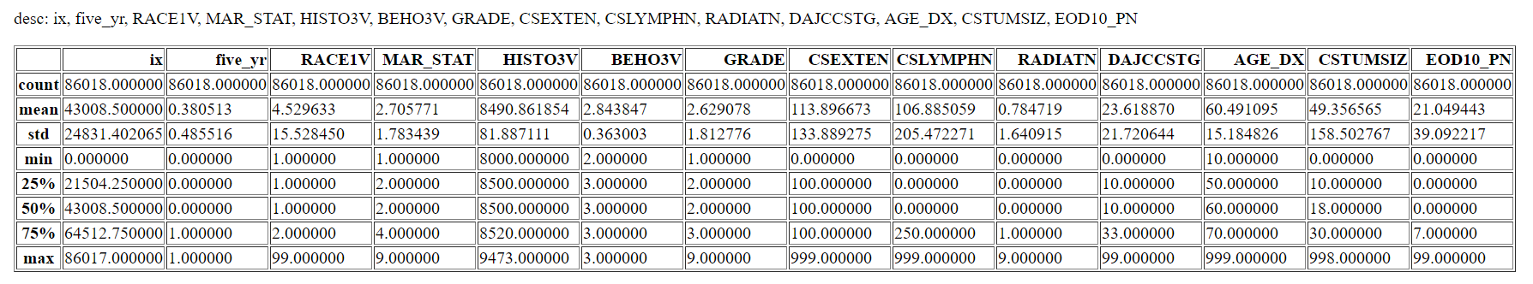
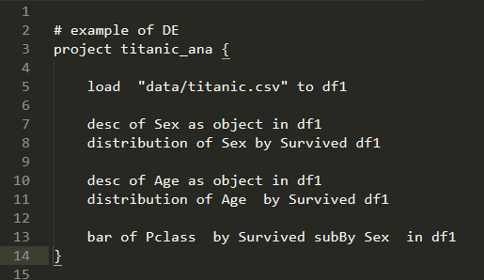
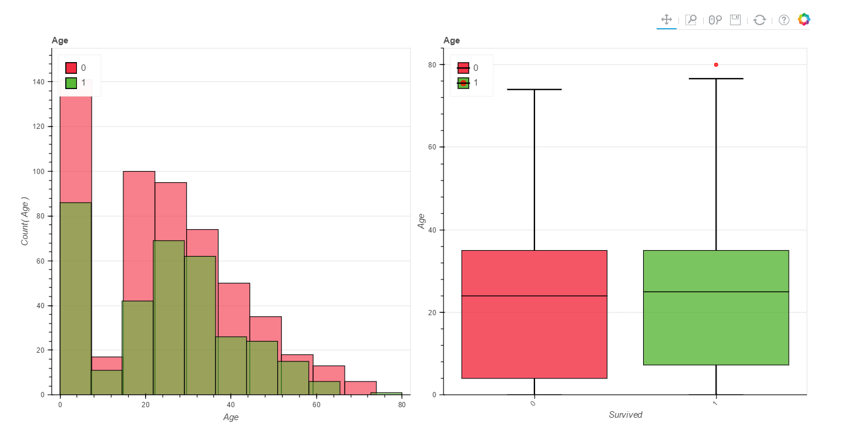
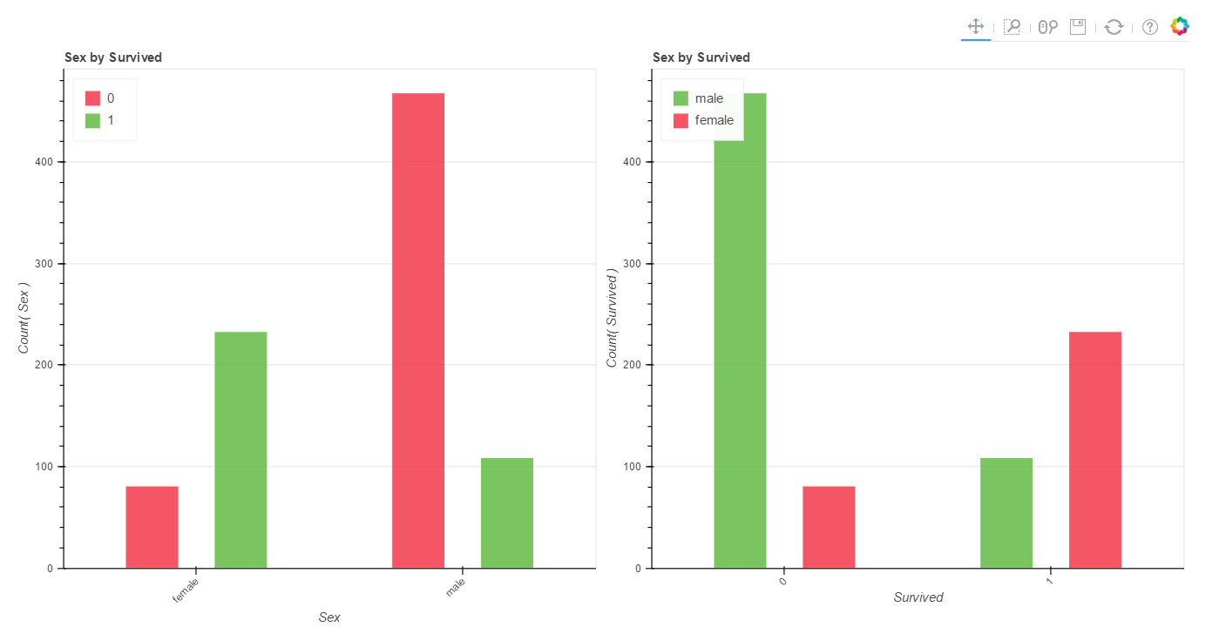
The goal
use a simple scripts to have a glance of the data.
Simple scripts
Complicated report

Slide 3
What inside the Data Explore (DE) language
The grammar is simple. Can do a lot of things with one command. (done)
Able to generate HTML format results (done)
Able to generate R, Python and Scala code. (ongoing)

Slide 4
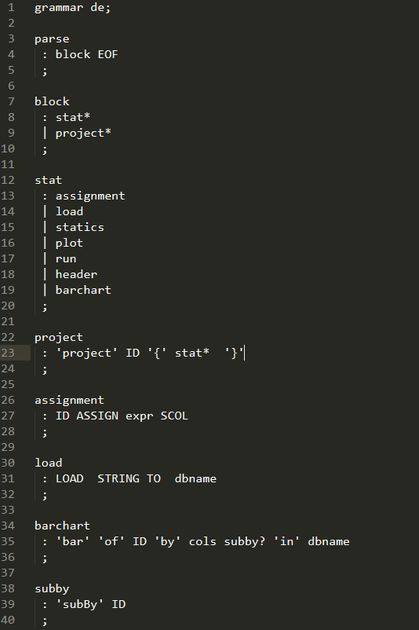
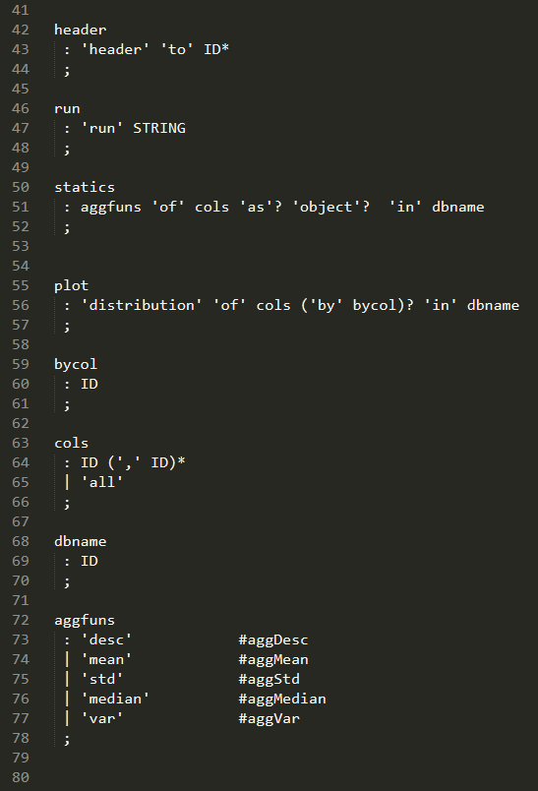
The grammar ( in ANTLR g4 syntax)

Slide 5
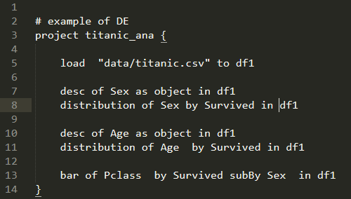
An Example
The “Titanic” data. It has name, age , class, survived and other info.
The code.

Slide 6
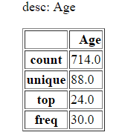
desc of Age as object in df1
distribution of Age by Survived in df1
Code:
Survived = 1
Not Survived = 0
It seems no correlation between “Age” and “Survived”.

Slide 7
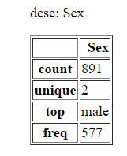
desc of Sex as object in df1
distribution of Sex by Survived in df1
Code:
Survived = 1
Not Survived = 0
male
female
The survived rate of female is much higher than male !

Slide 8
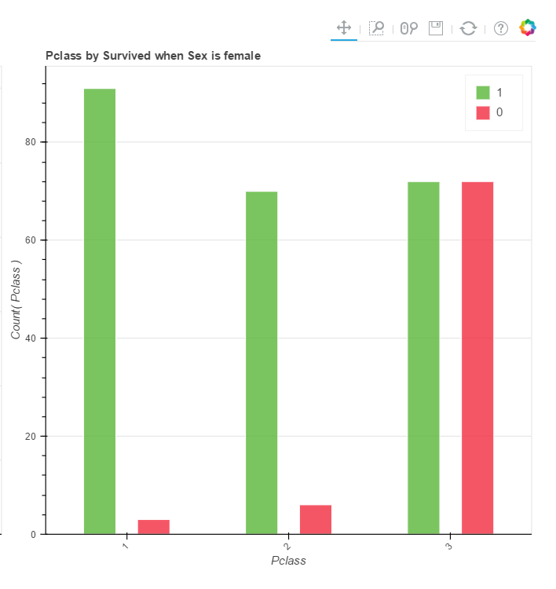
Code:
bar of Pclass by Survived subBy Sex in df1
This is a more detailed plot using DE.
In third class, female survived rate is much lower than first and second class!
Survived = 1
Not Survived = 0
First
class
Second
class
Third
class

Slide 9
More to do
Generate Java, Scala, R, and Python code from DE (Data Explore)code.
More charts.
Consider adding analytical models into DE.

